Slide 1
Lesson 2: Introduction to transcriptomics
Matteo Dugo, PhD
IRCCS Ospedale San Raffaele
Department of Medical Oncology – Breast Cancer Unit
Clinical translational and immunotherapy research

Slide 2
Biological interpretation – pathway analysis
How to interpret a list of dozens or hundreds of differentially expressed genes?
Pathway analysis helps interpret the data in the context of biological processes, pathways and networks
Goal - To reduce data dimensionality by arranging genes into pathways
Basic Assumption
Genes involved in the same biological process, functions or localizations present correlated behaviors in terms of expression levels.
We can apply statistical tests to find pathways that are significantly represented by our list of differentially expressed genes.

Slide 3
Overview of pathway analysis methods
Genes are ranked by differential statistic
(NO GENE SELECTION)
Expression Matrix
Functional Class Scoring (FCS)
GSEA
Differential Expression
Gene Set or Pathway DB
DEGs - UP
Over-Representation Analysis (ORA)
GO
IPA
Class A
Class B
NOT DE
DEGs -DOWN
Selection by threshold

Slide 4
Over-Representation Analysis (ORA)
Answer the question: “Is my gene list enriched for genes belonging to a certain pathway?”
An input gene list is created using a certain threshold or criteria (e.g.: differentially expressed genes between two conditions)
For each pathway, the number of input genes that are part of the pathway is calculated
Every pathway is tested for over- or under-representation in the list of input genes.
The output is a list of pathways with associated p-values for enrichment.
The p-value represent the probability to observe an overlap equal or greater than the observed by randomly sampling genes on the array.

Slide 5
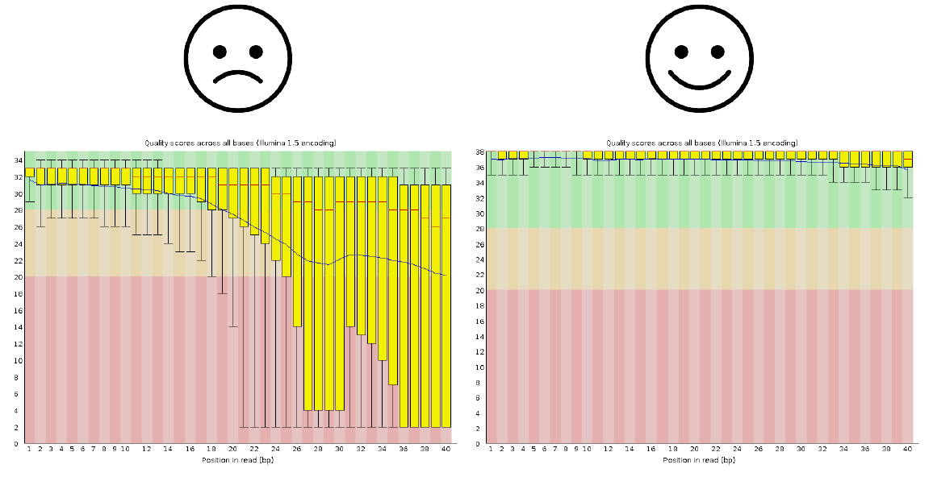
Over-Representation Analysis (ORA)
Gene list
(e.g. up-regulated genes)
Gene list
(e.g. up-regulated genes)
Gene set
Gene set
Gene Set or Pathway DB
Gene Set or Pathway DB
Background
(all genes on the array)
Background
(all genes on the array)
 | In gene set | Not in gene set
In my list | 48 | 2
Not in my list | 496 | 4499
 | In gene set | Not in gene set
In my list | 4 | 46
Not in my list | 496 | 4499
Calculate statistic and p-value of the gene set enrichment.
Chi-squared test
Hypergeometric test

Slide 6
Limitations of ORA
ORA does not take into account the size of the difference
The information about the extent of regulation (e.g. Fold change or significance) can be useful in assigning different weights to input genes
ORA uses only the most significant genes and discard the others
Marginally less significant genes (e.g. Fold change= 1.99 or p-value = 0.051) are missed, resulting in loss of information

Slide 7
Functional Class Scoring (FCS)
Answer the question: “Are genes of a certain gene set enriched toward the top or the bottom of my ranked gene list?”
Steps of FCS analysis:
A gene-level statistic is computed using the molecular measurements from an experiment (e.g. Fold change, signal-to-noise, t-statistic).
Genes are ranked according to the gene-level statistic
The gene-level statistics of all genes in a gene set are aggregated into a single gene set-level statistic.
Assess the statistical significance of the gene set-level statistic.

Slide 8
Functional Class Scoring (FCS)
A note on gene ranking…
The ranking of genes reflects the correlation of the genes with a phenotype of interest: gene are ranked from the most up-regulated to the most down-regulated
Rank ≠ Significance of differential expression
It is likely that the genes at the top or bottom of the ranked list are also significantly differentially expressed (e.g.: FDR < 0.05) but this is not always the case.

Slide 9
Functional Class Scoring (FCS)
FCS overcomes three limitations of ORA:
Do not require an arbitrary threshold for dividing expression data into significant and non-significant gene lists. FCS methods use all available measurements for pathway analysis. Useful when no significantly differentially expressed genes are detected.
While ORA completely ignores measurements when identifying significant pathways, FCS methods use this information to detect coordinated changes in th expression of genes in the same pathway.
By considering the coordinated changes in gene expression, FCS methods account for dependece between genes in a pathway

Slide 10
FCS software example: GSEA
Gene Set Enrichment Analysis (GSEA) is a computational method that determines whether an a priori defined set of genes shows statistically significant, concordant differences between two biological states (e.g. phenotypes).
Most used tool: 25377 citations (March 2021)

Slide 11

GSEA: overview
Experimental setup:
cell lines treated with drug A compared to control, balanced design
Goal: identify gene expression modifications related to treatment
Drug A
DMSO
x 4
x 4
RNA extraction
RNA-Sequencing

Slide 12
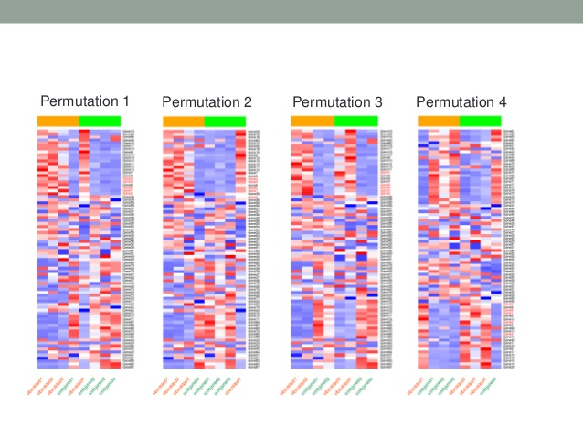
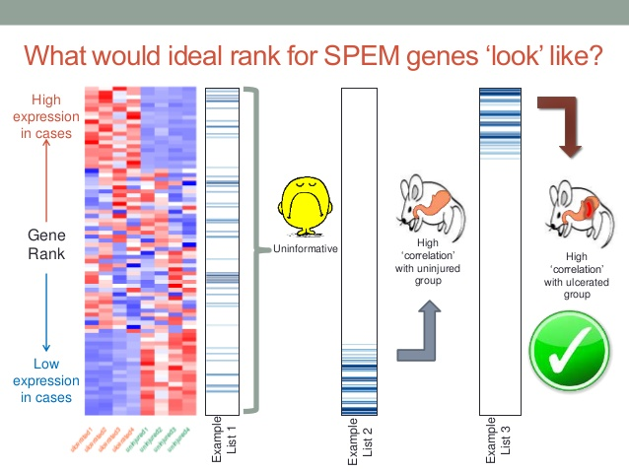
GSEA: overview
High expression in treated cell lines
Gene ranking
GSEA
Low expression in treated cell lines
Scenario 1
Genes of the gene set are enriched at the top of the ranked list: high correlation with treated group
Scenario 2
Genes of the gene set are enriched at the bottom of the ranked list: high correlation with control group
Scenario 3
Genes of the gene sets are randomly distributed: no correlation with phenotype

Slide 13
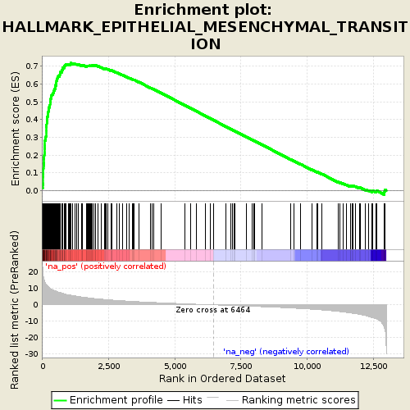
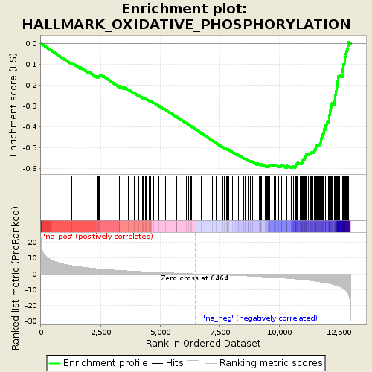
GSEA: enrichment calculation
Enrichment Score (ES): degree to which a gene set is over-represented at the top or bottom of a ranked list of genes.
Positive ES: gene set enrichment at the top of the ranked list
Negative ES: gene set enrichment at the bottom of the ranked list
ES
Running ES for the gene set as the analysis walks down the ranked list
ES
Where the members of the gene set appear in the ranked list
Value of the ranking metric as you move down the list of ranked genes
LEADING EDGE SUBSET – subset of genes of a gene set that contribute most to the ES
LEADING EDGE SUBSET
Normalized Enrichment Score (NES): primary statistic for examining gene set enrichment results. ES normalized for differences in gene set size and in correlations between gene sets and the expression dataset
NES can be used to compare analysis results across gene sets

Slide 14
GSEA: enrichment calculation
The nominal p-value estimates the statistical significance of the enrichment score for a single gene set.
P-values are calculated using permutations:
Based on phenotype: random phenotypes are created by shuffling the phenotype labels of the samples; recommended when there are at least 7 samples in each phenotype
Based on gene sets: random gene sets, size matched to the actual gene set, are created and their enrichment scores calculated on the original data; useful when you have too few samples to do phenotype permutations (that is, when you have fewer than seven (7) samples in any phenotype)

Slide 15
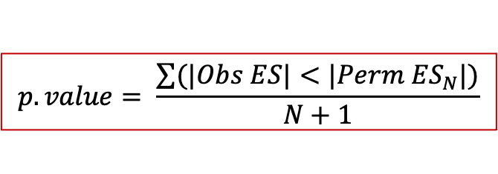
GSEA: enrichment calculation
Phenotype-based permutations
Original data
randomly shuffle phenotypes
N times
Re-ranking of genes based on permuted samples
Observed ES
Permuted ES₁
Permuted ES₂
Permuted ES₃
Permuted ES₄
$$p.value= \frac{\sum{(|Obs ES|<|Perm {ES}_{N}|)}}{N+1}$$

Slide 16
GSEA: enrichment calculation
Gene set-based permutations
Original data
Original data
Original data
Original data
Original data
Generate N random gene sets of the SAME SIZE of the actual gene set
Calculate ES for each random gene set on the original data
Observed ES
Permuted ES₁
Permuted ES₂
Permuted ES₃
Permuted ES₄
$$p.value= \frac{\sum{(|Obs ES|<|Perm {ES}_{N}|)}}{N+1}$$

Slide 17
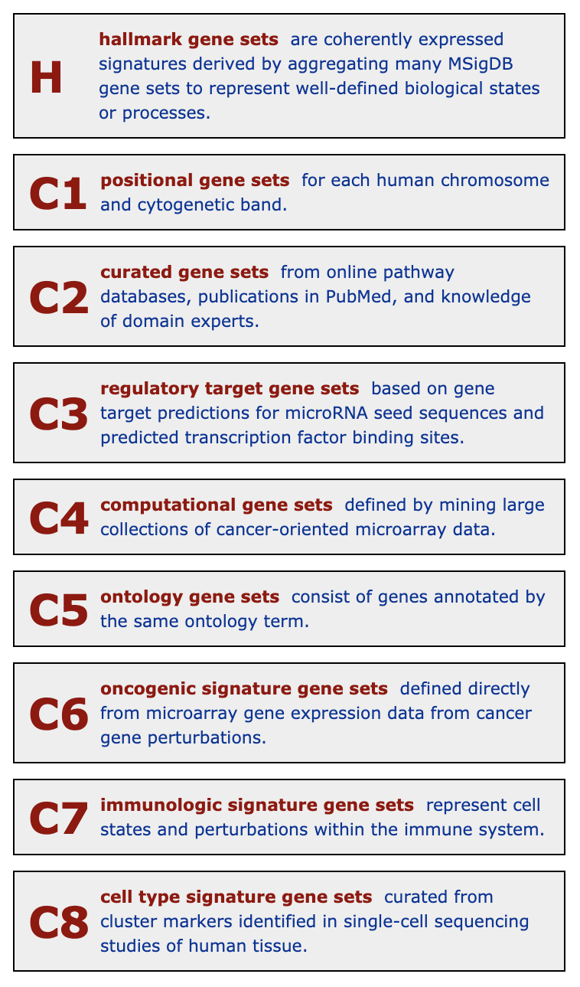
Gene sets collections
Gene sets are collected at the Molecular Signatures Database (MSigDB, http://software.broadinstitute.org/gsea/msigdb/index.jsp).
Custom gene sets can be used.
The MSigDB gene sets are divided into 9 major collections.
For an overview of the major biological processes pick the HALLMARK collection.

Slide 18
Let’s go practical
Using the results obtained from the analysis of the example gene expression datasets of previous lesson we will perform:
Over-representation analysis
GSEA
Classical mode
Pre-ranked mode

Slide 19
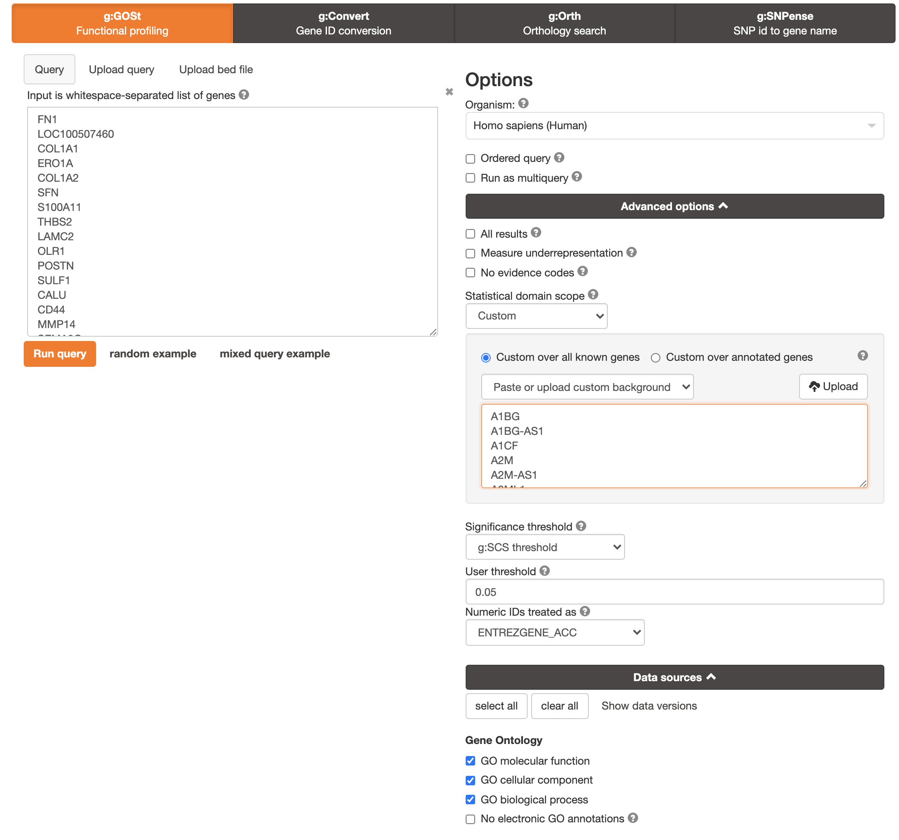
Let’s go practical – Over-representation analysis
Many tools exist for functional over-representation analysis:
DAVID (free, https://david.ncifcrf.gov/tools.jsp)
Ingenuity Pathway Analysis (Not free, access under request at INT)
gProfiler (free, https://biit.cs.ut.ee/gprofiler/gost)
Select organism
Background gene list. Better use custom gene list (all genes in your gene expression experiment). If not available leave default settings.
Input gene list of DEGs. Analyze Up- and Down- regulated genes separately
Multiple testing correction method
Significance threshold
Gene identifier
Select gene set sources of your interest

Slide 20
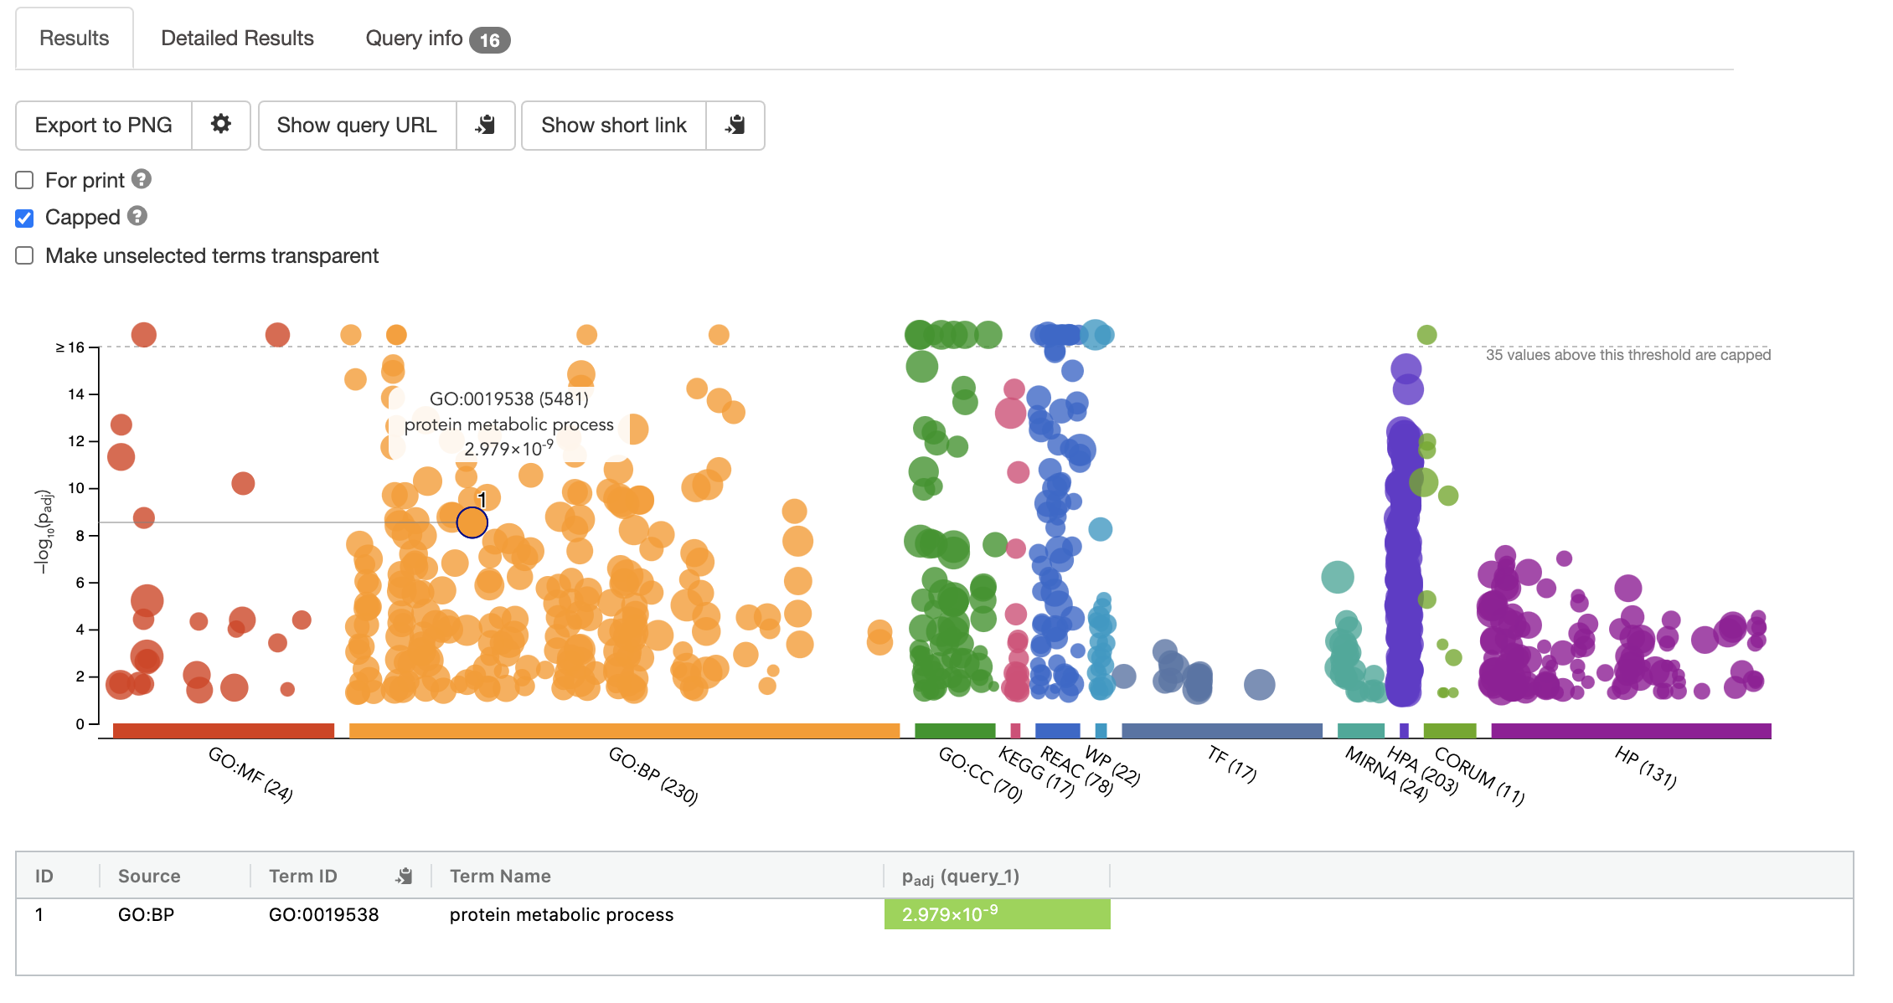
Let’s go practical – Over-representation analysis
gProfiler
Interactive plot results
Each dot represents a gene set. Divided by source.
Y-axes: -log₁₀(adjusted p-value). Higher values, more significant.

Slide 21
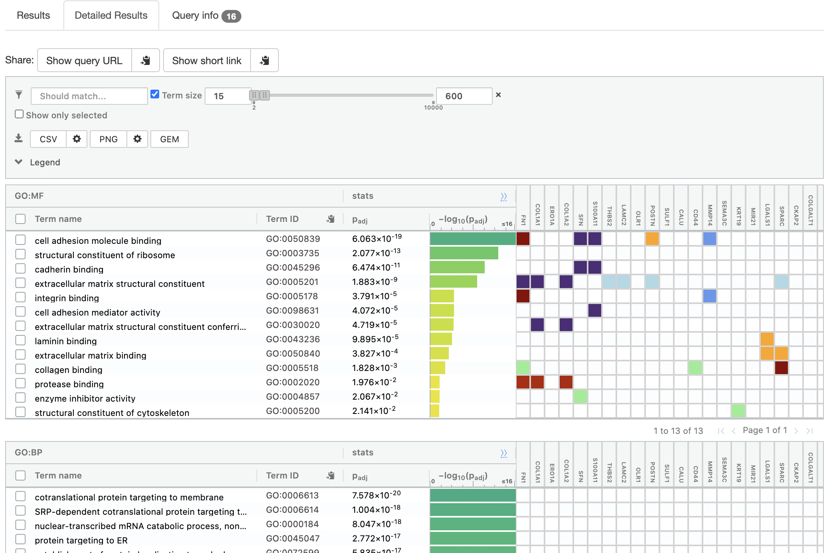
Let’s go practical – Over-representation analysis
gProfiler
Table results
Gene sets with statistical results. Divided by source.
Limit the size of the gene sets. Reasonable sizes: min=15; max=600
Genes of the gene sets that belong to your input list. Colors depend on the evidence (see legend)
Download results in excel format
Evidence legend

Slide 22
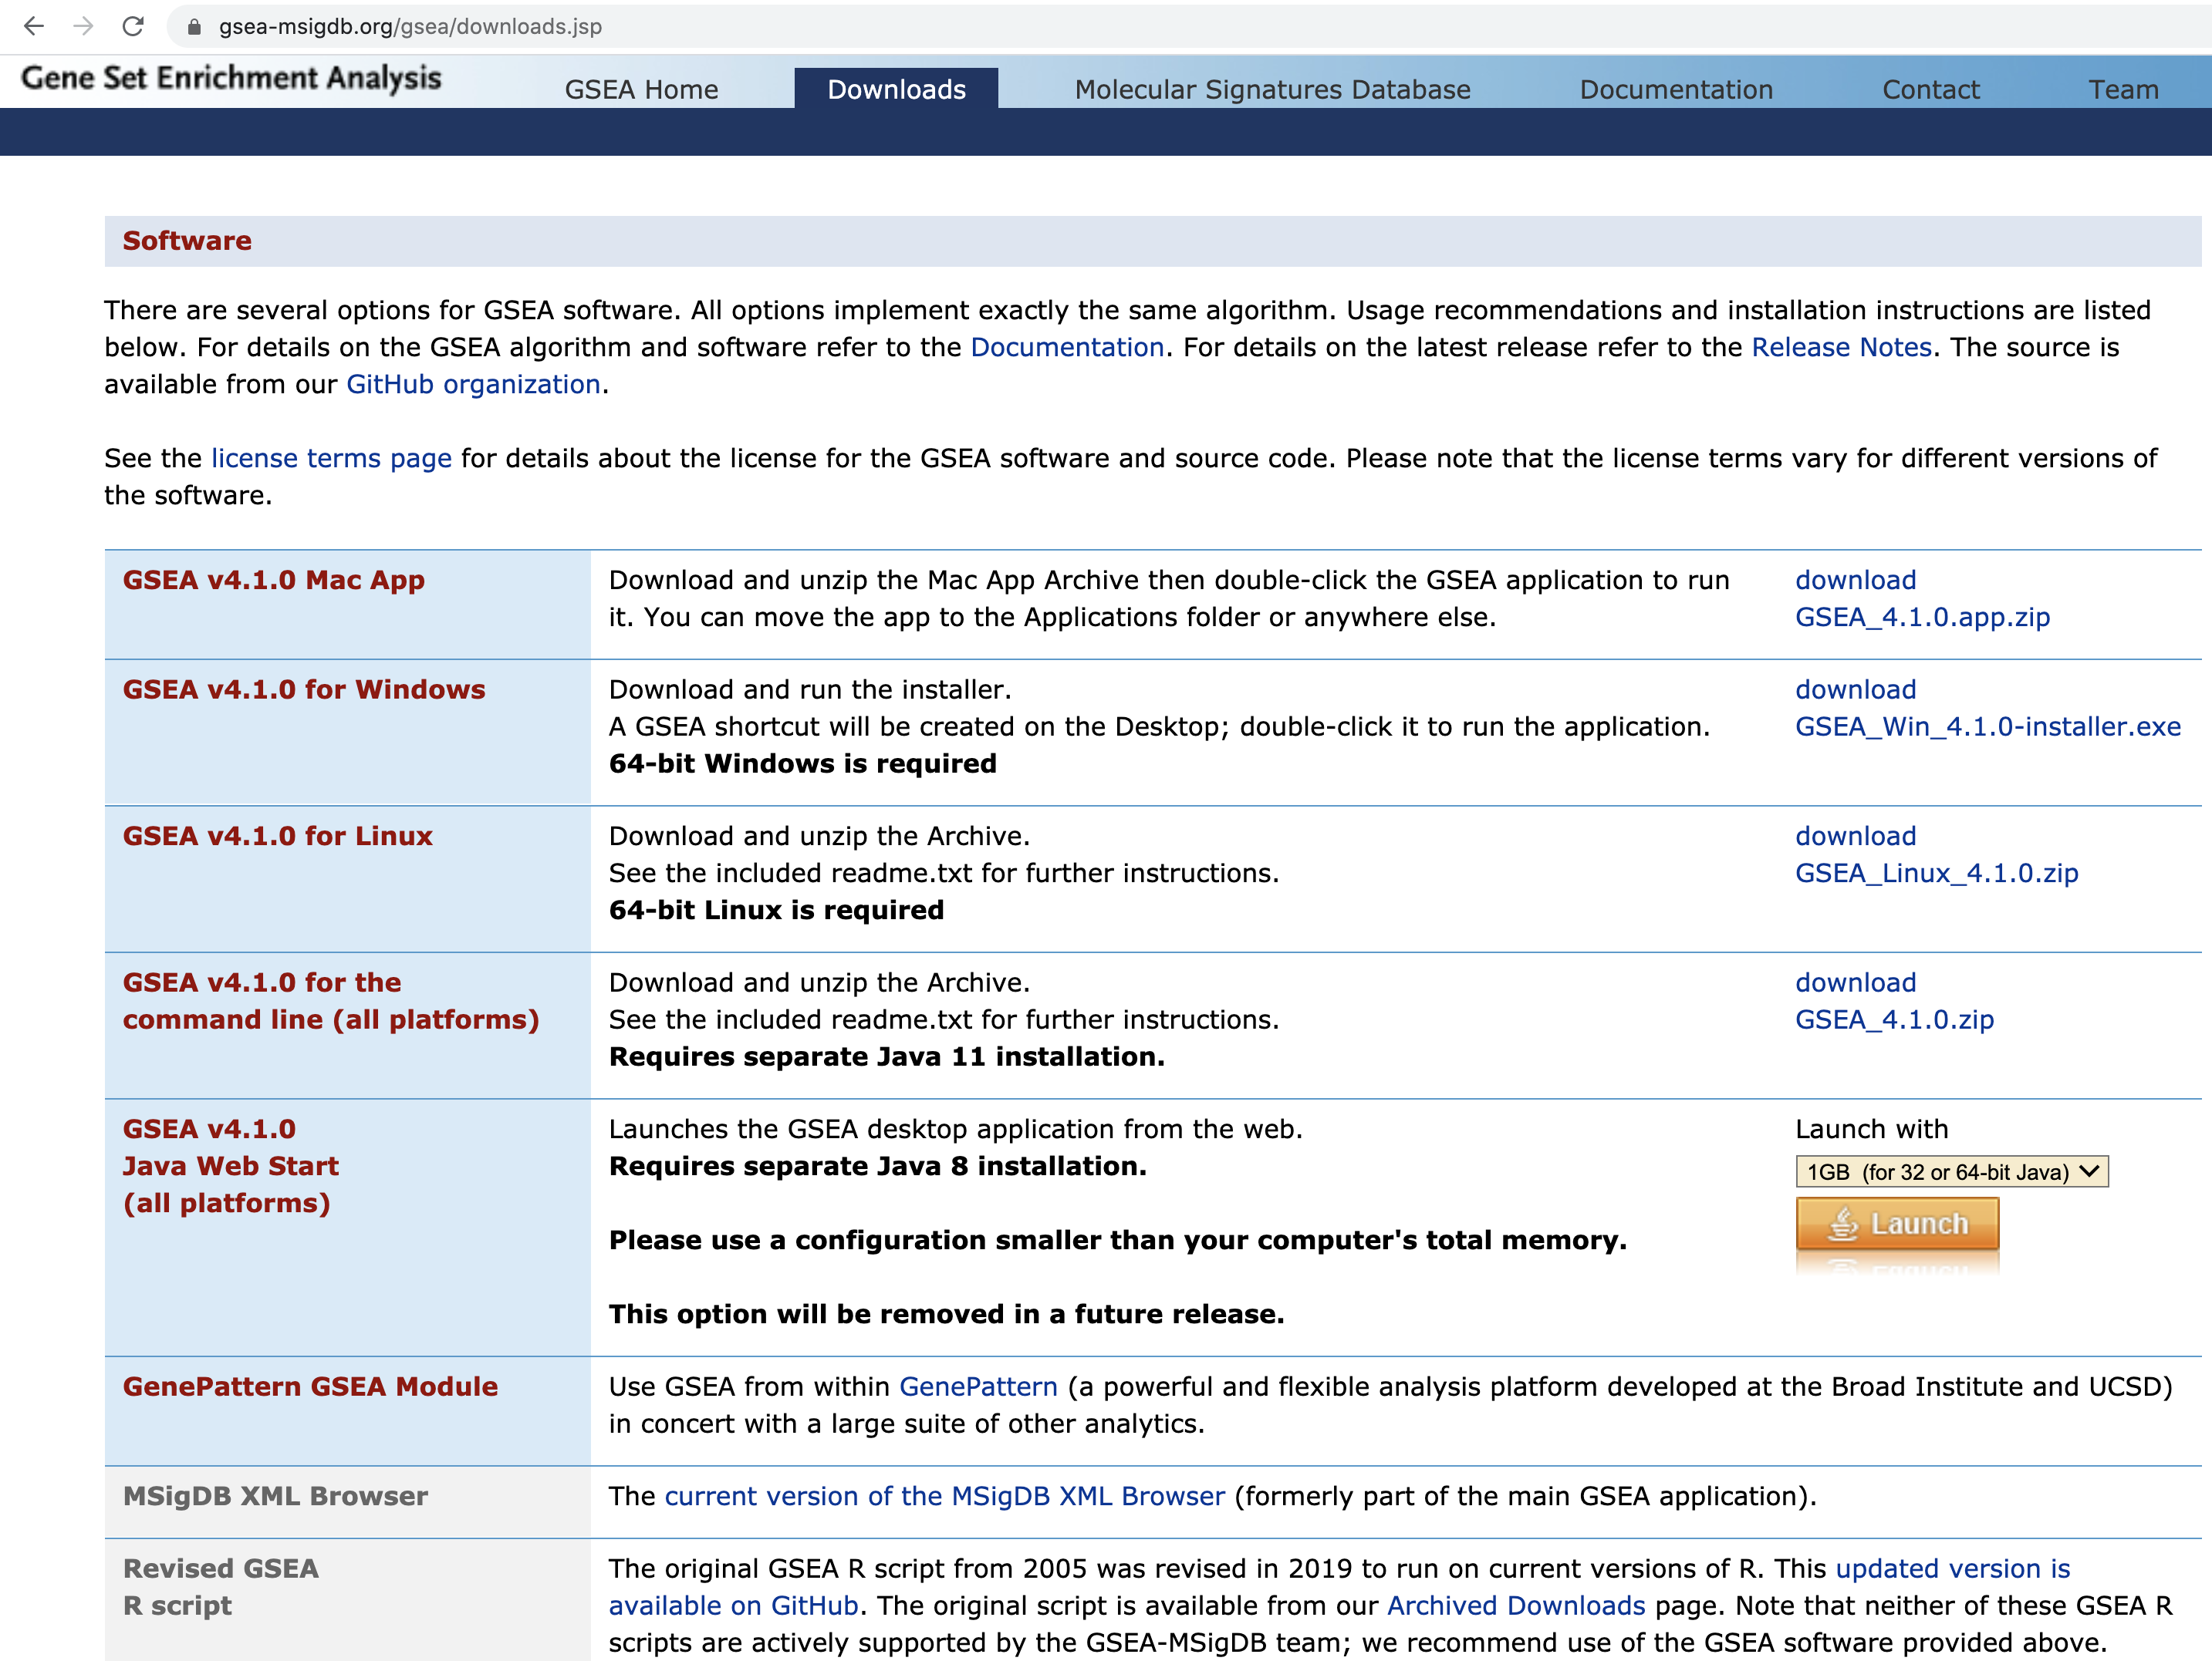
Let’s go practical – GSEA
Installer for Mac
Installer for Windows
Launch without installing

Slide 23
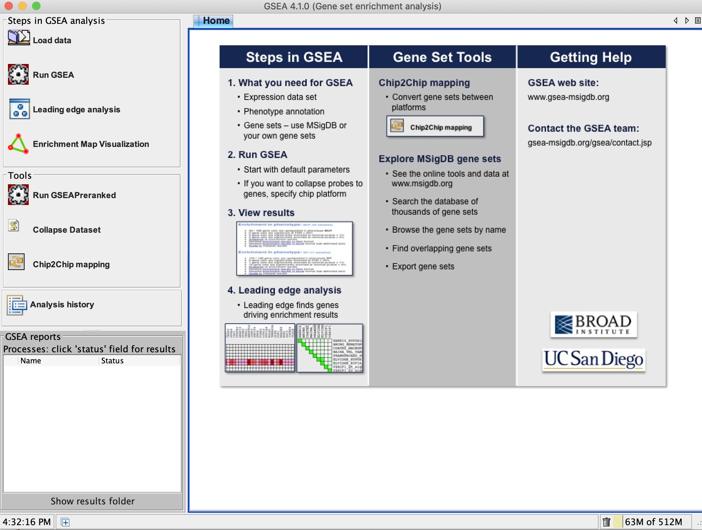
Let’s go practical – GSEA
STEP 1 – Load required data
STEP 2A – Run Classic GSEA
STEP 2B – Run pre-ranked GSEA

Slide 24
Let’s go practical – GSEA
Input data and file formats
See http://software.broadinstitute.org/cancer/software/gsea/wiki/index.php/Data_formats for details
Approach | Data File | Content | Format | Source
Classic GSEA | Expression dataset | Contains features (genes or probes), samples, and an expression value for each feature in each sample. | res, gct, pcl, or txt | You create the file.
 | Phenotype labels | Contains phenotype labels and associates each sample with a phenotype. | cls | You create the file or have GSEA create it for you.
 | Gene sets | Contains one or more gene sets. For each gene set, gives the gene set name and list of features (genes or probes) in that gene set. | gmx, gmt or grp | You use the files hosted on the GSEA-MSigDB file servers, export gene sets from the Molecular Signature Database (MSigDB), or create your own gene sets file.
Pre-ranked GSEA | Ranked gene list | Two column file with the ranking of the genes according to a statistical metric previously calculated. First column contains gene symbols, column 2 the ranking statistic | rnk | You create the file (e.g.: from a differential expression analysis).
 | Gene sets | Contains one or more gene sets. For each gene set, gives the gene set name and list of features (genes or probes) in that gene set. | gmx, gmt or grp | You use the files hosted on the GSEA-MSigDB file servers, export gene sets from the Molecular Signature Database (MSigDB), or create your own gene sets file.

Slide 25
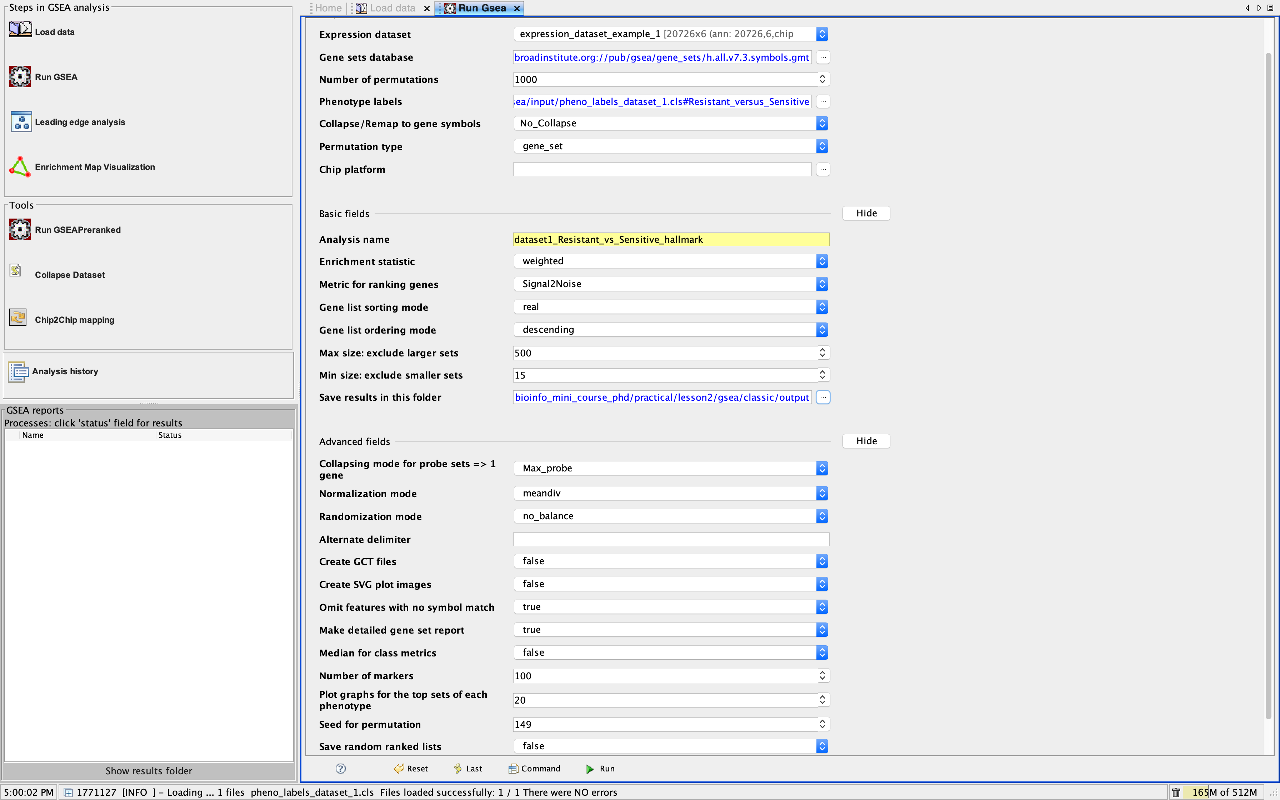
Let’s go practical – GSEA
Running classical GSEA
Select the expression dataset
Select the gene set collection
Select the direction of the comparison
If your dataset has no duplicated gene symbols select “No_Collapse”
Select the permutation type
Give a meaningful name to the analysis
Select the output folder
Select 149 to have reproducible results
Run the analysis

Slide 26
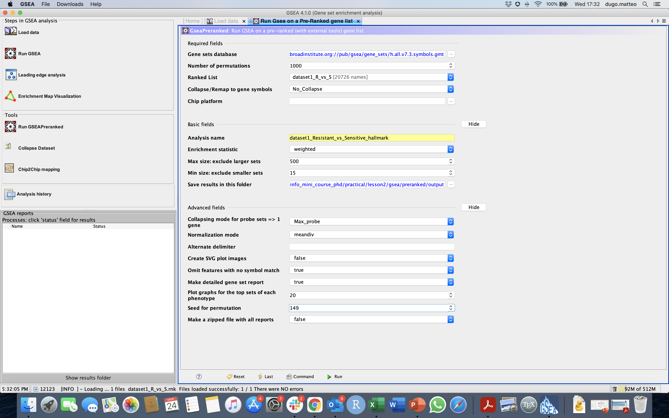
Let’s go practical – GSEA
Running pre-ranked GSEA
Select the expression dataset
Select the gene set collection
Select the pre-ranked gene list
If your dataset has no duplicated gene symbols select “No_Collapse”
Give a meaningful name to the analysis
Select the output folder
Select 149 to have reproducible results
Run the analysis

Slide 27
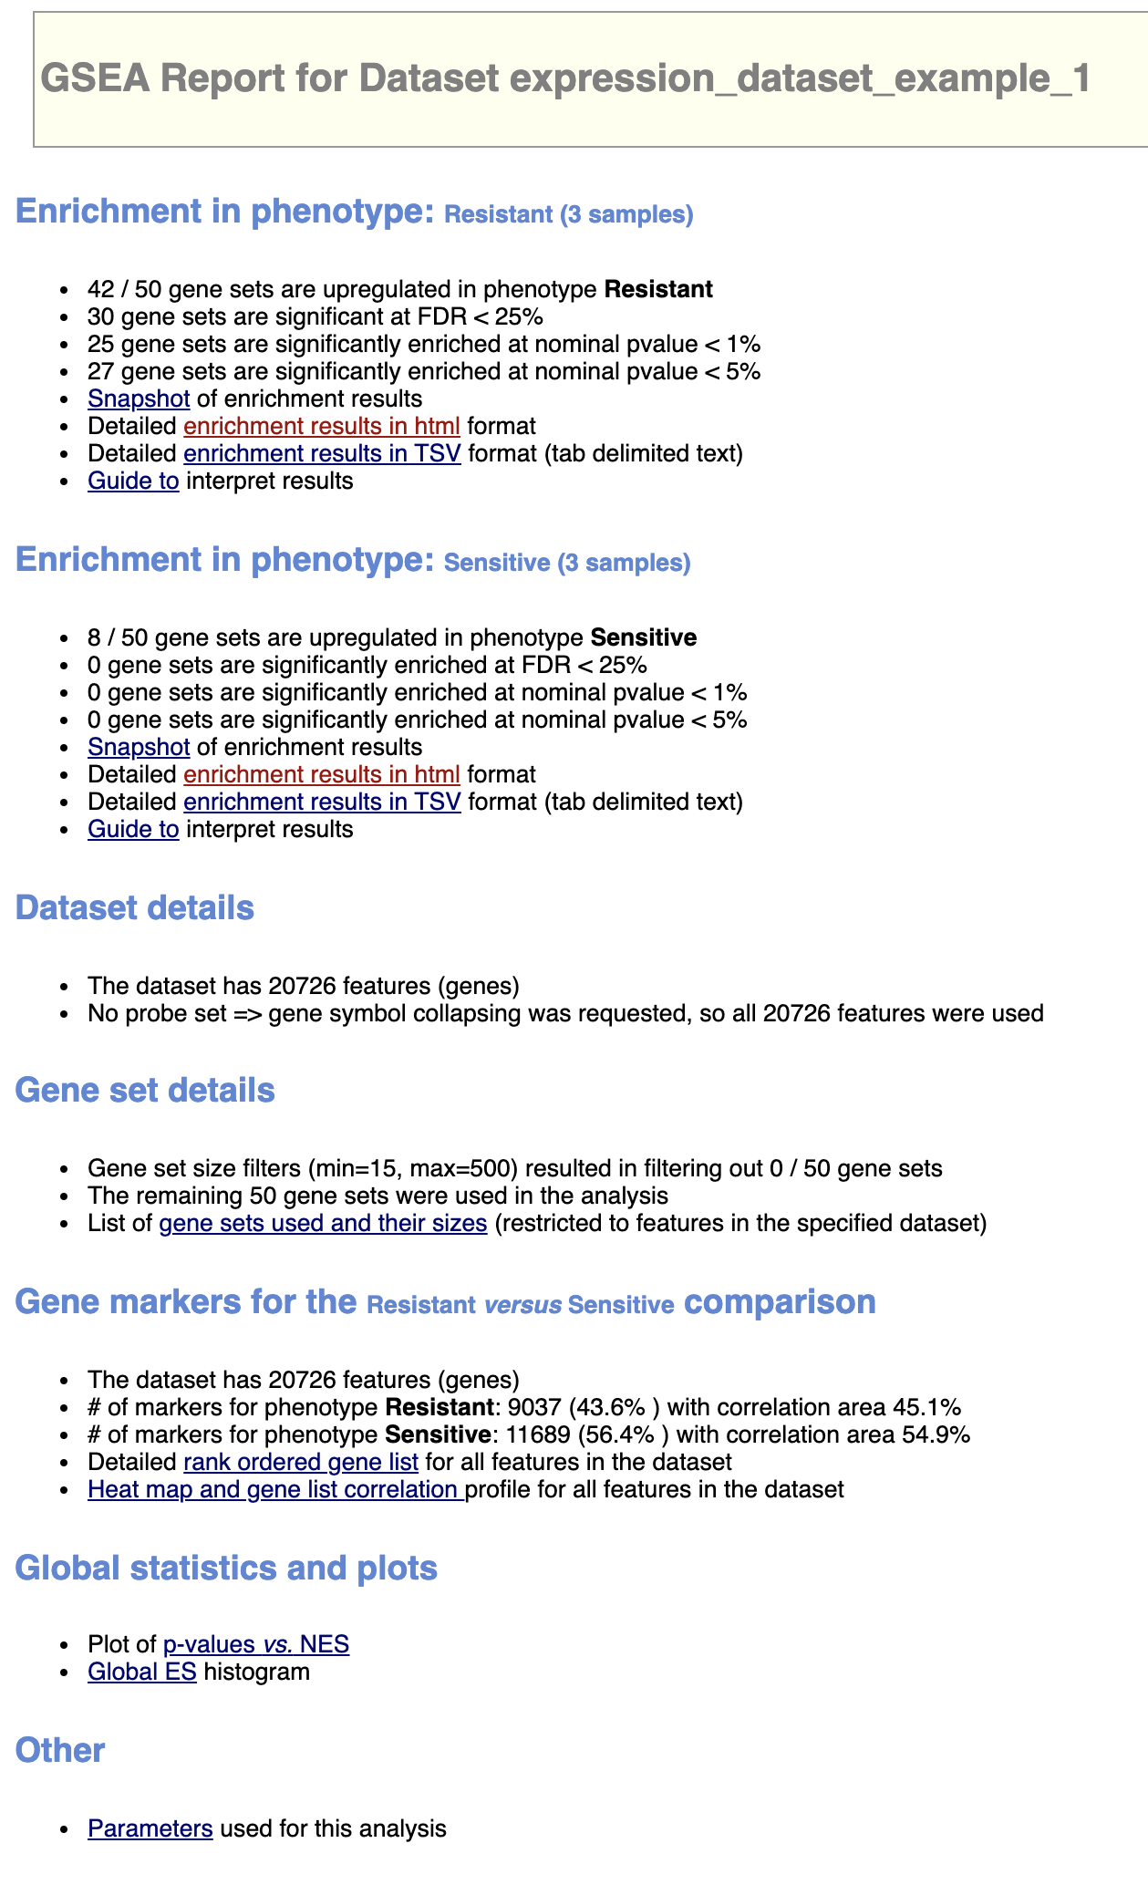
Let’s go practical – GSEA
Output
Open the index.html file in your output folder using an internet browser
Results for gene sets that have a positive enrichment score in your phenotype (gene sets that show enrichment at the top of the ranked list)
Results for gene sets that have a negative enrichment score in your phenotype (gene sets that show enrichment at the bottom of the ranked list)
Information about the expression dataset
Information about the gene sets
Information about the ranked list of genes used for the analysis

Slide 28
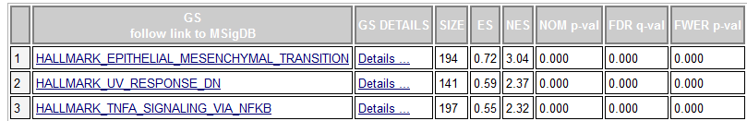
GSEA: interpreting the results
Output
Click on enrichment results in html link in your index file to open detailed results.
Column | Description
GS | Gene set name. Click the gene set name for a detailed description of the gene set.
GS DETAILS | For the top 20 gene sets, click the Details link to display the Gene Set Details Report.
SIZE | Number of genes in the gene set after filtering out those genes not in the expression dataset
ES | Enrichment score for the gene set; that is, the degree to which this gene set is overrepresented at the top or bottom of the ranked list of genes in the expression dataset.
NES | Normalized enrichment score; that is, the enrichment score for the gene set after it has been normalized across analyzed gene sets.
NOM p-value | Nominal p value; that is, the statistical significance of the enrichment score. The nominal p value is not adjusted for gene set size or multiple hypothesis testing; therefore, it is of limited use in comparing gene sets.
FDR q-value | False discovery rate; that is, the estimated probability that the normalized enrichment score represents a false positive finding.
FWER p-value | Bonferroni adjusted p-value. Because the goal of GSEA is to generate hypotheses, the GSEA team recommends focusing on the FDR statistic.
LEADING EDGE SUBSET – subset of genes of a gene set that contribute most to the ES

Slide 29
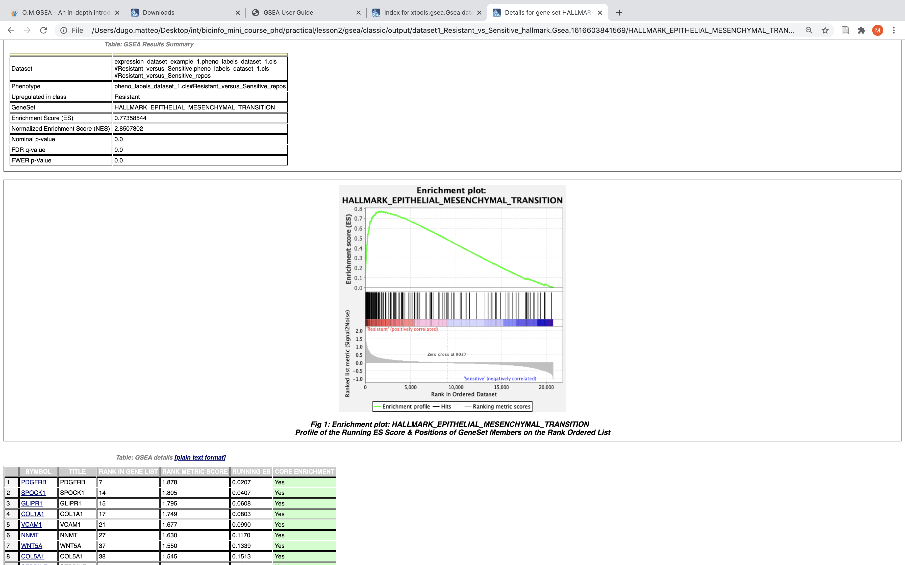
Let’s go practical – GSEA
Output
Click on “Details…” link for a specific gene set.
Enrichment plot
Statistical summary for the gene set
Gene set details
RANK IN GENE LIST | Position of the gene in the ranked list of genes.
RANK METRIC SCORE | Score used to position the gene in the ranked list.
RUNNING ES | Running enrichment score; that is, the enrichment score at this point in the ranked list of genes.
CORE ENRICHMENT | Genes with a Yes value in this column contribute to the leading-edge subset within the gene set. This is the subset of genes that contributes most to the enrichment result. Use the Leading Edge analysis to analyze the overlap between multiple leading-edge subsets.

Slide 30
References and additional material
gProfiler paper
Raudvere, U. et al. g:Profiler: a web server for functional enrichment analysis and conversions of gene lists (2019 update). Nucleic Acids Res. 47, W191–W198 (2019).
gProfiler User guide
https://biit.cs.ut.ee/gprofiler/page/docs
GSEA paper
Subramanian, A. et al. Gene set enrichment analysis: A knowledge-based approach for interpreting genome-wide expression profiles. Proc. Natl. Acad. Sci. 102, 15545–15550 (2005).
GSEA User guide
https://www.gsea-msigdb.org/gsea/doc/GSEAUserGuideFrame.html
GSEA file formats
http://software.broadinstitute.org/cancer/software/gsea/wiki/index.php/Data_formats
Useful paper for functional analysis of omics data
Reimand, J. et al. Pathway enrichment analysis and visualization of omics data using g:Profiler, GSEA, Cytoscape and EnrichmentMap. Nat. Protoc. 14, 482–517 (2019).

